Slide 1
Object Oriented Programming ICT-1203
Dr. Jesmin Akhter
Associate Professor, IIT, JU

Slide 2


Class declaration
A class is a template for manufacturing objects. You declare a class by specifying the class keyword followed by a non-reserved identifier that names it. A pair of matching open and close brace characters ({ and }) follow and delimit the class's body.
A class's body is populated with fields, methods, and constructors. Combining these language features into classes is known as encapsulation.

Slide 3
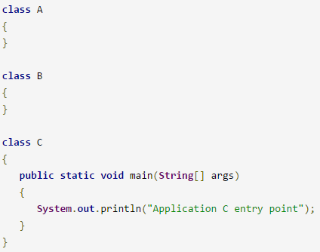
Multi-class applications and main()
A Java application is implemented by one or more classes. Small applications can be accommodated by a single class, but larger applications often require multiple classes. In that case one of the classes is designated as the main class and contains the main() entry-point method.

Slide 4
Object in Java
An entity that has state and behavior is known as an object e.g. chair, bike, marker, pen, table, car etc. It can be physical or logical.
An object has three characteristics:
state: represents data (value) of an object.
behavior: represents the behavior (functionality) of an object such as deposit, withdraw etc.
identity: Object identity is typically implemented via a unique ID.
Object is an instance of a class.
Class is a template or blueprint from which objects are created. So object is the instance(result) of a class.
Variable defined within the class is called instance variable because each instance of the class (each object of the class)contains it’s own copy of these variables. Thus the data for one object is separate and unique from the data for another.

Slide 5

A Simple Class
Let a class called Box that defines three instance variables: width, height, depth.
A class defines a new type of data. In this case, the new data type is called Box. We will use this name to declare objects of type Box. It is important to remember that a class declaration only creates a template; it does not create an actual object.
To actually create a Box object, you will use a statement like the following:
Box mybox = new Box(); // create a Box object called mybox
The new keyword is used to allocate memory at runtime

Slide 6
A Simple Class
each time you create an instance of a class, you are creating an object that contains its own copy of each instance variable defined by the class. Thus, every Box object will contain its own copies of the instance variables width, height, and depth.
To access these variables, you will use the dot (.) operator. The dot operator links the name of the object with the name of an instance variable.
For example, mybox.width = 100;

Slide 7
Declaring Objects
you must acquire an actual, physical copy of the object and assign it to that variable.
You can do this using the new operator. The new operator dynamically allocates (that is, allocates at run time) memory for an object and returns a reference to it.
This reference is, more or less, the address in memory of the object allocated by new. This reference is then stored in the variable. Thus, in Java, all class objects must be dynamically allocated.

Slide 8
Declaring Objects
To declare an object of type Box:
mybox = new Box();
This statement combines the two steps just described. It can be rewritten like this to show each step more clearly:
Box mybox; // declare reference to object
mybox = new Box(); // allocate a Box object

Slide 9
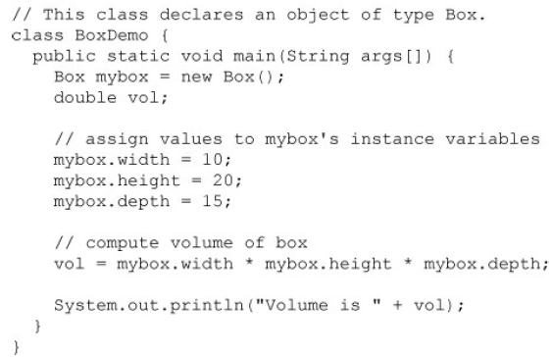
Here is a complete program that uses the Box class

Slide 10
Creating multiple objects by one type only
Each object has its own copies of the instance variables. This means that if you have two Box objects, each has its own copy of depth, width, and height.
It is important to understand that changes to the instance variables of one object have no effect on the instance variables of another.

Slide 11
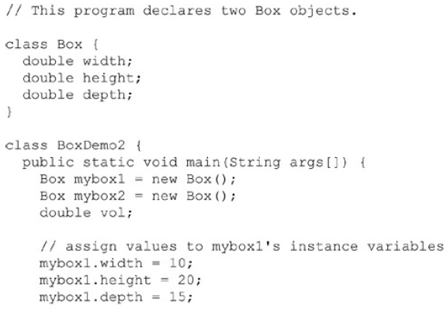
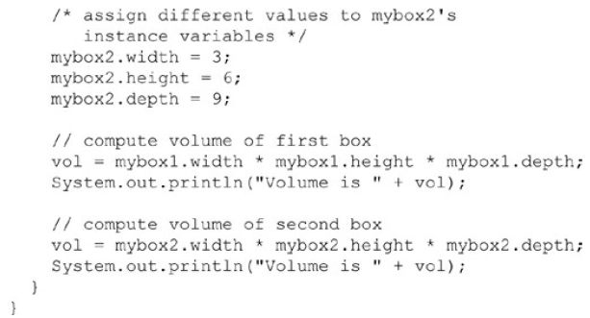
Creating multiple objects by one type only

Slide 12
class Box
{
double height, width, depth;
void insert (double h, double w, double d)
{
height=h;
width=w;
depth=d;
}
void volume()
{
double vol=height*width*depth;
System.out.println(vol);
}
}
public class VolumeBox {
public static void main(String[] args) {
Box mybox1=new Box();
Box mybox2=new Box();
mybox1.insert (6,5,2);
mybox1.volume();
mybox2.insert (7,6,4);
mybox2.volume();
}
}

Slide 13
public class VolumeBox {
public static void main(String[] args) {
Box mybox1=new Box();
Box mybox2=new Box();
double volume;
volume=mybox1.insert (6,5,2);
mybox1.display();
volume=mybox2.insert (7,6,4);
mybox2.display();
}
}
class Box
{
double height, width, depth;
double vol;
double insert (double h, double w, double d)
{
height=h;
width=w;
depth=d;
vol=height*width*depth;
return vol;
}
void display()
{
System.out.println(vol);
}
}

Slide 14
Assigning Object Reference Variables
Box b1 = new Box();
Box b2 = b1;
You might think that b2 is being assigned a reference to a copy of the object referred to by b1. That is, you might think that b1 and b2 refer to separate and distinct objects.
However, this would be wrong. Instead, after this fragment executes, b1 and b2 will both refer to the same object.
The assignment of b1 to b2 did not allocate any memory or copy any part of the original object. It simply makes b2 refer to the same object as does b1. Thus, any changes made to the object through b2 will affect the object to which b1 is referring, since they are the same object.

Slide 15
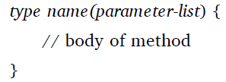
Introducing Methods
The general form of a method:
Here, type specifies the type of data returned by the method. This can be any valid type, including class types that you create. If the method does not return a value, its return type must be void. The name of the method is specified by name.
The parameter-list is a sequence of type and identifier pairs separated by commas.

Slide 16
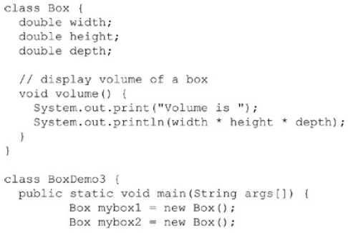
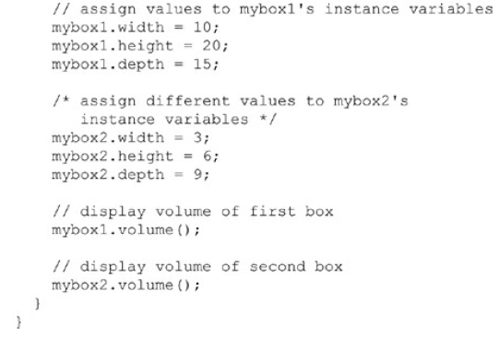
Volume method does not return a value

Slide 17
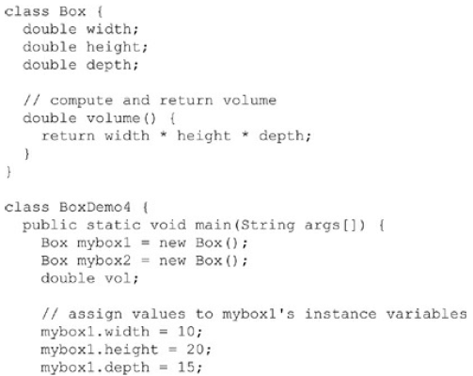
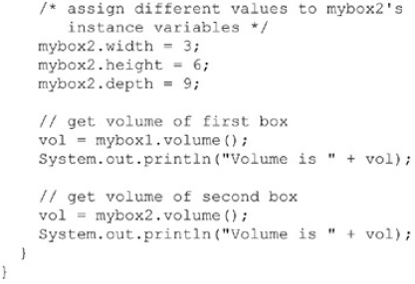
Volume method returns a value

Slide 18
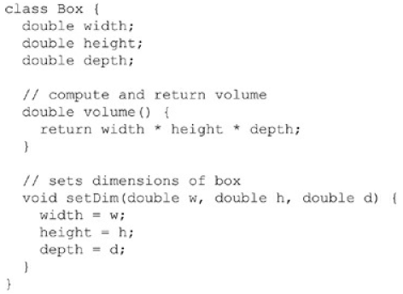
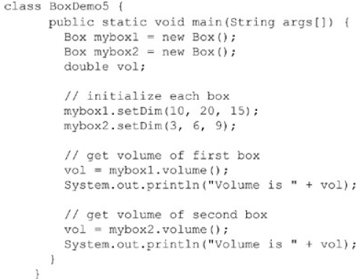
Adding a method that takes parameters

Slide 19
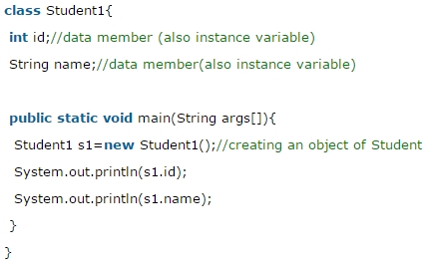
Simple Example of Object and Class
The new keyword is used to allocate memory at runtime

Slide 20
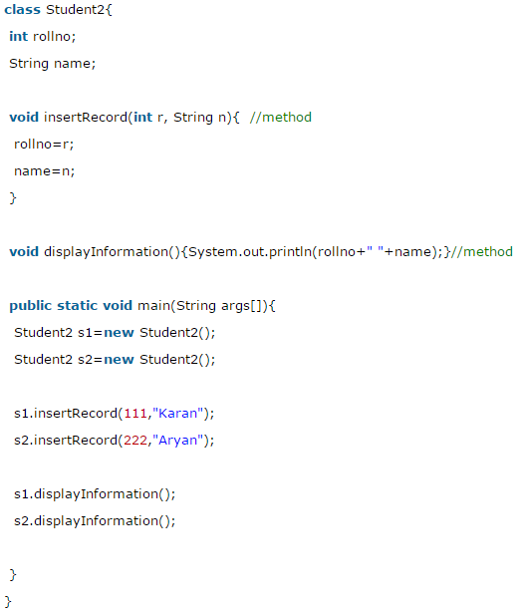
Example of Object and class that maintains the records of students

Slide 21
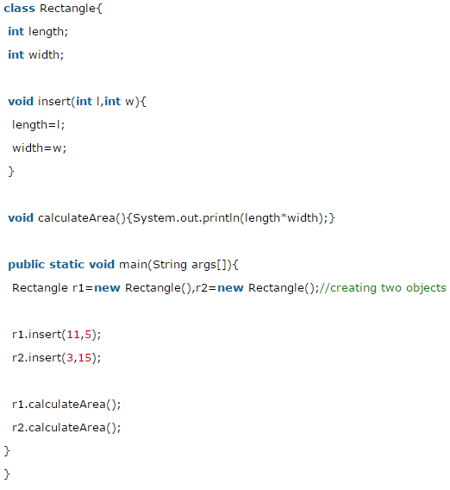
Creating multiple objects by one type only

Slide 22
Thank you

